Slide 1

ENSN201 – Enterprise Social Networks
Version 2 – 18th December 2015

Slide 2
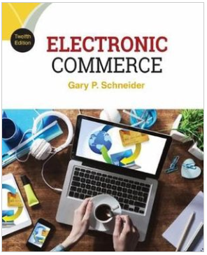
Resource Material
Electronic Commerce, 12th Edition
Gary Schneider
ISBN-10: 1305867815 | ISBN-13: 9781305867819 © 2017
Cengage Learning Australia

Slide 3
Week 5 : Chapter 9
Electronic Commerce Software

Slide 4
Learning Objectives
In this chapter, you will learn:
How to find and evaluate Web-hosting services
What functions are performed by electronic commerce software
How electronic commerce software works with database and ERP software
What enterprise application integration and Web services are and how they can be used with electronic commerce software
Notes:
4

Slide 5
Learning Objectives (cont’d.)
Which types of electronic commerce software are used by small, medium, and large businesses
How electronic commerce software works with customer relationships management, knowledge management, and supply chain management software
Notes:
5

Slide 6
Basic Functions of Electronic Commerce Software
All electronic commerce solutions must provide
Catalog display, shopping cart capabilities and transaction processing
Larger complex sites may include software with added features and capabilities

Slide 7
Catalog Display Software
Catalog organizes goods and services being sold
May organize by logical departments
Web store advantage is a single product may appear in multiple categories
Catalog is a listing of goods and services
Static catalog is a simple list written in HTML
Must edit HTML to add or delete items
Dynamic catalog stores information in a database with photos, detailed descriptions and a search tool for locating item and determining availability
Both located in third tier of Web site architecture

Slide 8
Shopping Cart Software
Early electronic commerce used forms-based shopping
Shoppers selected items by filling out online forms which was awkward if ordering more than one or two items and error prone
Electronic shopping carts are now standard
Keep track of items customer selected and allows them to view cart contents, add and remove items
Ordering requires a simple click which executes the purchase transaction
Screen asks for billing and shipping information

Slide 9
Shopping Cart Software (cont’d.)
Web is a stateless system that does not retain information from one transmission to another
Shopping cart software must store information
Cookies allows information to be stored and retrieved
If browser does not allow cookie storage software automatically assigns temporary number
Dynamic pricing management software adjusts prices in real time based on variables seller chooses
Promotion management software allows sellers to create special offers on specific products

Slide 10
Shopping Cart Software (cont’d.)
Fulfillment integration software connects seller’s shopping cart to fulfillment provider’s computer
Shipping automatically triggered at completed sale
Product review management software allows customers to post reviews of products
Product recommendation triggers are tools that respond to customer’s product selection
Provides suggestions for related products, refills
Abandoned cart management software enables shopping cart to be retained for later when customer session is terminated

Slide 11
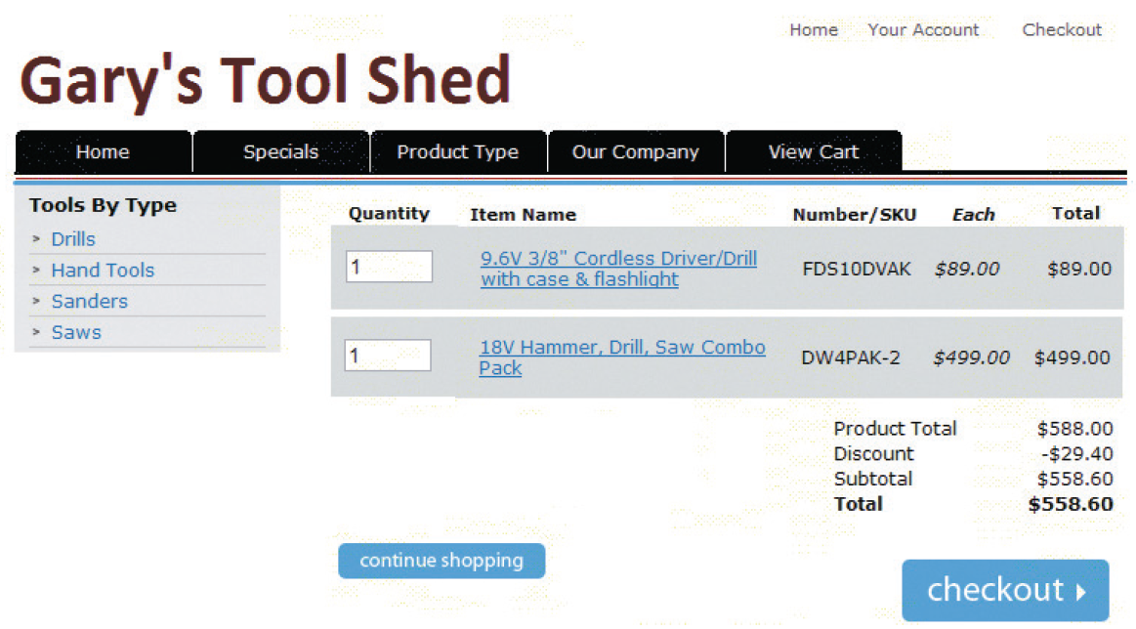
© Cengage Learning 2017
FIGURE 9-1 Typical shopping cart page

Slide 12
Transaction Processing
Occurs when shopper proceeds to virtual checkout counter by clicking the checkout button
Electronic commerce software performs calculations
Web browser software and seller’s Web server software switch into secure communication state
Electronic commerce software communicates with accounting software sales and inventory modules
FedEx and UPS shipping rate software integrates with electronic commerce software
Other calculations include coupons, promotions, time-sensitive offers

Slide 13
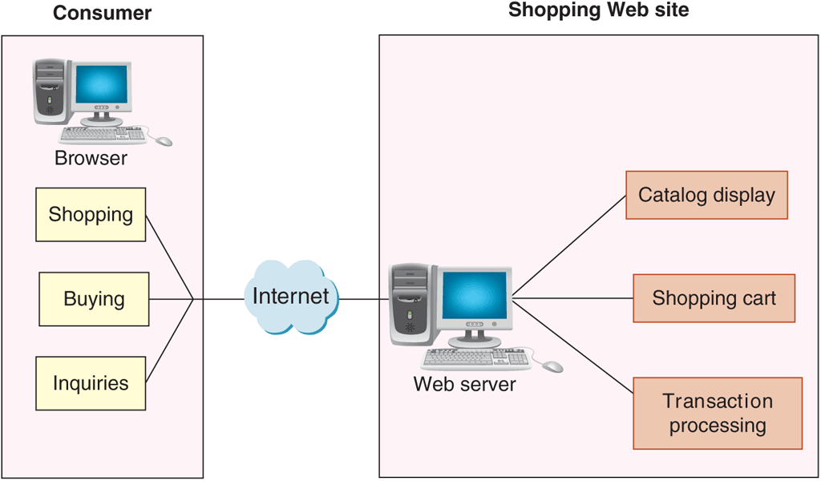
© Cengage Learning 2017
FIGURE 9-2 Basic electronic commerce site architecture
13

Slide 14
How Electronic Commerce Software Works with Other Software
Most large companies with electronic commerce operations also have substantial business activity unrelated to electronic commerce
Important to integrate electronic commerce activities into the company’s other operations
Basic information system element is a collection of databases

Slide 15
Databases
Highly structured information stored on a computer
Business rules are how the company does business
Database management software allows users to enter, edit, update, retrieve database information
Distributed information systems are large systems storing data in many different physical locations
Distributed database systems are databases within distributed information systems
MySQL database is open-source software owned by Oracle and maintained by group of programmers

Slide 16
Middleware
Middleware takes sales and inventory shipments information from electronic commerce software
Transmits to accounting and inventory management software
Companies can write their own or purchase customized middleware
Interoperability is making information systems work together
Middleware cost range is $30,000 to several millions
Depending on complexity and existing systems

Slide 17
Enterprise Application Integration
Application software (application) is a program that performs specific function like creating invoices
Application server (computer) takes request messages received by Web server
Runs application program performing action based on request message’s contents
Actions determined by business logic rules such as verifying customer password upon log in
Enterprise application integration is a creation of links among scattered applications so business logic can be interconnected

Slide 18
Enterprise Application Integration (cont’d.)
As information is transferred from one application to another program data formats differ
Must edit and reformat often using XML data feeds
Page-based application systems return pages generated by scripts containing rules
Present data on Web page with the business logic
Component-based application systems separate presentation logic from business logic
Logic components created and maintained separately
Updating and changing system elements much easier

Slide 19
Integration with ERP Systems
Enterprise resource planning (ERP) software are business systems integrating all facets of a business
Accounting, logistics, manufacturing, marketing, planning, project management, and treasury functions
Two major ERP vendors: Oracle and SAP
ERP software installation costs between $1 million and $10 million for a midsize company
Smaller online businesses can purchase products like NetSuite that offer ERP system subscriptions
Called software as a service (SaaS)

Slide 20
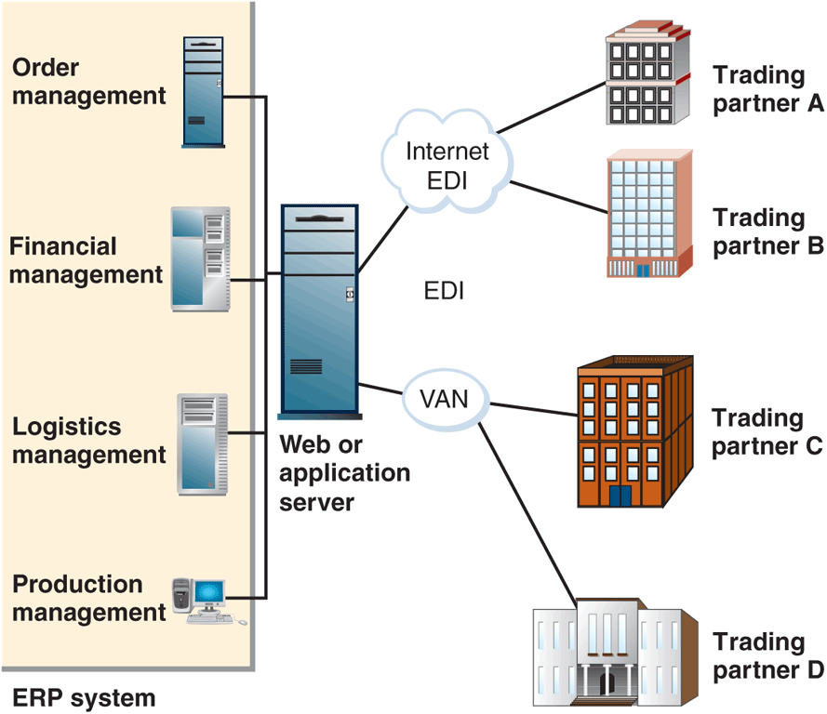
© Cengage Learning 2017
FIGURE 9-3 ERP system integration with EDI

Slide 21
Web Services
Software systems supporting interoperable machine-to-machine interaction over a network
Set of software and technologies allowing computers to use the Web to interact with each other directly
Does not require human operators directing the specific interactions
Application program interface (API) is a general name for the ways programs interconnect with each other
Web APIs: interaction over the Web

Slide 22
What Web Services Can Do and How Web Services Work
Offer improved customer service, reduced costs
Transmit XML-tagged data from one enterprise integrated application to another
Provide data feeds between two different companies
Programmers write software accessing business application logic units without knowing details
Allows communication between programs written in different languages on different platforms
Example task: transaction processing
Can be combined with other Web services for complex tasks

Slide 23
How Web Services Work (cont’d.)
Machine-to-machine communication was originally accomplished with HTML but now most are XML
First Web services information sources programmers incorporated into software applications
More advanced example is purchasing software used to obtain vendor price information
Purchasing agent authorizes transaction and Web services submits order and tracks until delivered
As Web servers become more sophisticated, they can often make decisions themselves

Slide 24
Web Services Specifications
Simple Object Access Protocol (SOAP) is a message-passing protocol
Defines how to send marked up data from one software application to another across a network
Utilizes three rule sets
Communication rules included in SOAP specification
Web Services Description Language (WSDL) describes logic unit characteristics of each Web service
Universal Description, Discovery, and Integration Specification (UDDI) woks as address book to identify Web services locations and associated descriptions

Slide 25
REST and RESTful Design
Representational State Transfer (REST)
Principle describing how the Web uses networking architecture to identify and locate Web pages and elements making up those Web pages
RESTful design (RESTful applications) are Web services built on the REST model
Transfers structured information from one Web location to another
Services accessible at a specific address
More than half of all Web services today are RESTful applications

Slide 26
Electronic Commerce for Small and Midsize Businesses: Basic CSPs
Use of service provider’s shared or dedicated hosting services
Shifts staffing burden from company to Web host
Spread costs over all hosted businesses
Host provider keeps server working through storms and power outages
CSPs offer free or low-cost e-commerce software
Less than $20 per month with software built into site
CSP examples
Gate.com, ProHosting.com, 1&1 Internet, Yahoo!

Slide 27
Mall-Style CSPs
Provide small businesses with basic Web site, online store design tools, templates and easy-to-use interfaces
Low monthly fee, one-time setup fees and percentage (or fixed) amount for each transaction
Shopping cart software and payment processing
Two-main mall-style CSPs are Amazon services for business and eBay stores for businesses
No long term commitment and few up-front costs

Slide 28
Estimating Operating Expenses for a Small Web Business
Cost to become operational between $400 and $8200
Assumes less than 100 items for sale and business already has computer and Internet access
Figure 9-4 shows the range of estimates for first-year expenses for a small business owners
Self-hosting include one time basic server and router costs of $2000 to $10,000 plus annual costs
Basic Internet connection: $480 to $1,800
Secure server room: $5000
Required technicians: $50,000 to $100,000
Annual total costs: $60,000 to $100,000

Slide 29
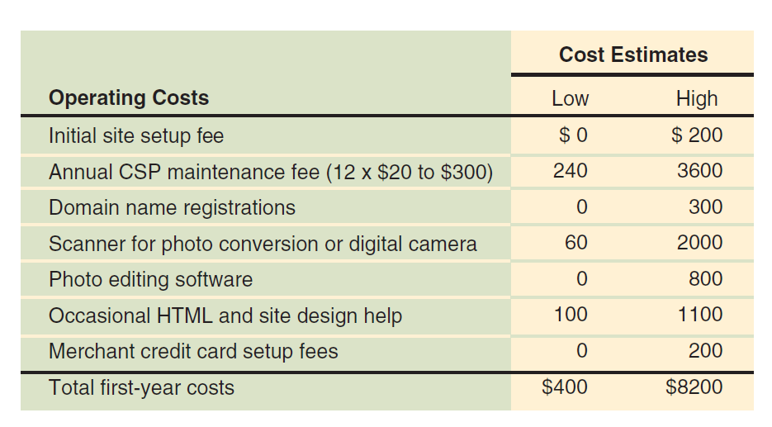
© Cengage Learning 2017
FIGURE 9-4 Approximate costs to put a small store online

Slide 30
Electronic Commerce Software for Midsize Businesses: Web Site Development Tools
Possible to use Web page creation and site management tools from Chapter 2
After Web site creation add purchased software elements and create the middleware

Slide 31
Midrange Electronic Commerce Software
Costs $5000 to $200,000
Operating costs range $1000 to $30,000 annually
Offers connectivity to database or ERP systems that store inventory information
Intershop offers midrange packages
Include search and catalog capabilities, electronic shopping carts, credit card processing and connection to back-end businesses and databases
Setup wizards, catalog tools, data management functions and built-in templates are included
Manage storefronts with Web browser interface

Slide 32
Midrange Electronic Commerce Software (cont’d.)
IBM WebSphere Commerce Professional is a family of software components
Includes catalog templates, setup wizards, advanced catalog tools
Provides link with existing corporate systems
Inventory databases, procurement systems
Customization requires programmers with JavaScript, Java or C++ expertise
Costs between $50,000 and $300,000 depending on number of servers and options

Slide 33
Electronic Commerce Software for Large Businesses
Larger business requirement many of the same advanced capabilities as midsize firms
Need ability to handle higher transaction loads and dedicated software applications to handle specific online business elements
Enterprise-class commerce software is used in large online business operations
Encompasses all areas of the business or enterprise
Provides tools for B2B and B2C commerce
Interacts with wide variety of existing systems
Costs: $200,000 to $10 million

Slide 34
Enterprise-Class Electronic Commerce Software
Requires several dedicated computers, Web server system, firewalls
IBM WebSphere Commerce Enterprise, Oracle E-Business Suite and Broadvision
Provides tools for linking to and supporting supply and purchasing activities
Secure transaction processing and fulfillment
Interaction with firm’s inventory system to issue purchase orders
Generate accounting entries
Download electronic goods directly from site

Slide 35
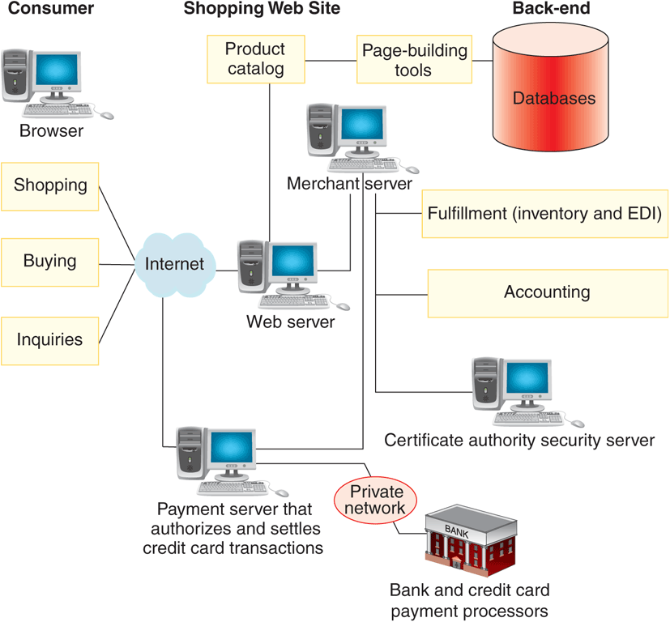
© Cengage Learning 2017
FIGURE 9-5 Typical enterprise-class electronic commerce architecture

Slide 36
Content Management Software
Helps control large amounts of text, graphics, media files that have become crucial to doing business
Increased use of social media and networking as part of online business operations
Software should be tested before commitment
Straightforward procedures for regular maintenance
Facilitates typical content creation tasks
Leading providers include IBM and Oracle
Costs between $50,000 and $500,000
Can cost 3 to 4 times that amount to customize, configure and implement

Slide 37
Knowledge Management Software
Systems that manage knowledge itself rather than the documentary representations of that knowledge
Collect, organize and share knowledge
Enhance collaboration and preserve knowledge gained through information use to benefit future users
Tools to read documents and conduct searches
Use proprietary semantic, statistical algorithms
Collects knowledge elements by extracting them from normal interactions users have with information
Implementation costs $10,000 to $1 million or more

Slide 38
Supply Chain Management Software
Helps coordinate planning and operations with supply chain partners
SCM planning software develops coordinated demand forecasts
SCM execution software helps with warehouse and transportation management
SCM software components manage demand and supply planning and demand fulfillment
Cost of SCM software implementations varies tremendously based on number of locations
Range from under $300,000 to $5 million

Slide 39
Customer Relationship Management Software
Goal is to understand customer’s specific needs and customize product or service to meet those needs
Idea is if customer needs are met exactly they will pay more for goods or services
Software must obtain data from operations software and gather data about customer activities
Use data to conduct analytical activities
Basic form of CRM uses customer information to sell more goods or services
Advanced form of CRM delivers attractive, positive customer experiences

Slide 40
Customer Relationship Management Software (cont’d.)
Important in maintaining customer loyalty when purchase process is long and complex
From 1996 to 2000 companies spent millions to buy systems and restructure customer strategies
Bad experiences led to a change in thinking
Now used to solve smaller, more specific problems
Popular target is call center operations
Some companies create their own but most buy a software package
Prices start around $2000 and large implementations can cost millions

Slide 41
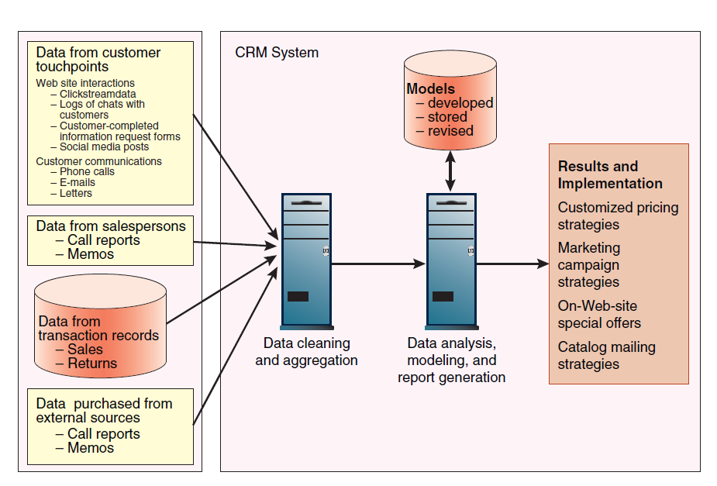
© Cengage Learning 2017
FIGURE 9-6 Elements of a CRM system

Slide 42

kent.edu.au Kent Institute Australia Pty. Ltd. ABN 49 003 577 302 ● CRICOS Code: 00161E ● RTO Code: 90458 ● TEQSA Provider Number: PRV12051

